Slide 1
AWS analytics pipeline

Slide 2
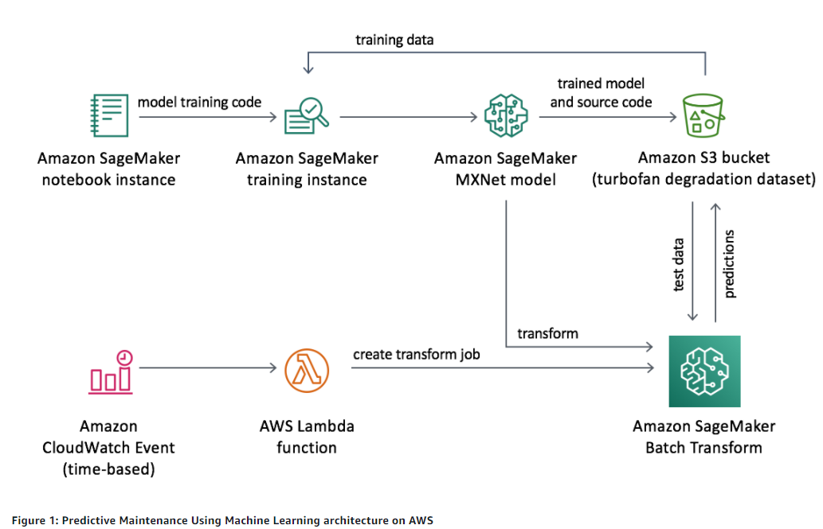
AWS Predictive maintenance

Slide 3
Amazon SageMaker

Slide 4
Amazon CloudWatch Events
Events
An event indicates a change in AWS environment
E.g. EC2 instance changes from pending to running
Rules
A rule matches incoming events and routes them to targets
Targets
A target processes events
E.g. Lambda functions, EC2 instances

Slide 5
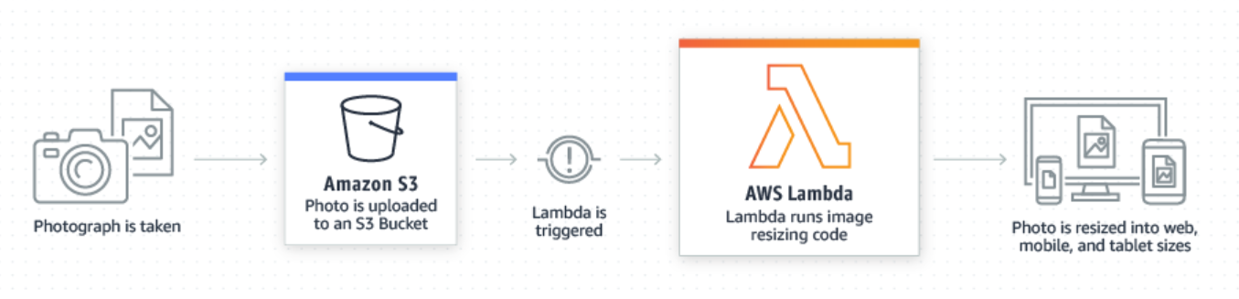
AWS Lambda
Configure code to run in response to events

